Slide 1
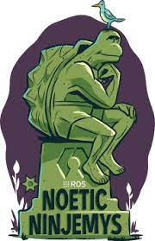



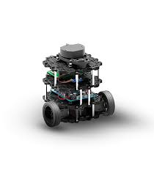
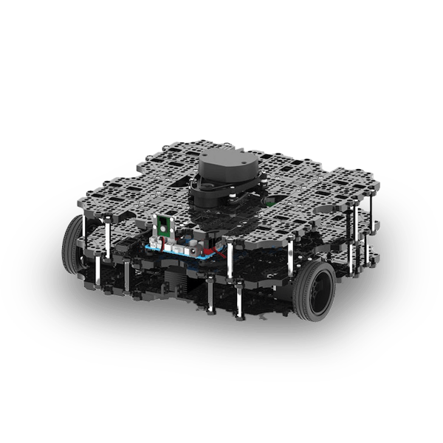

Introduction to ROS and Gazebo
Mr.KRITTINUNT CHOBTRONG
krittinunt@gmail.com

Slide 2
History of Mobile Robot

Slide 3
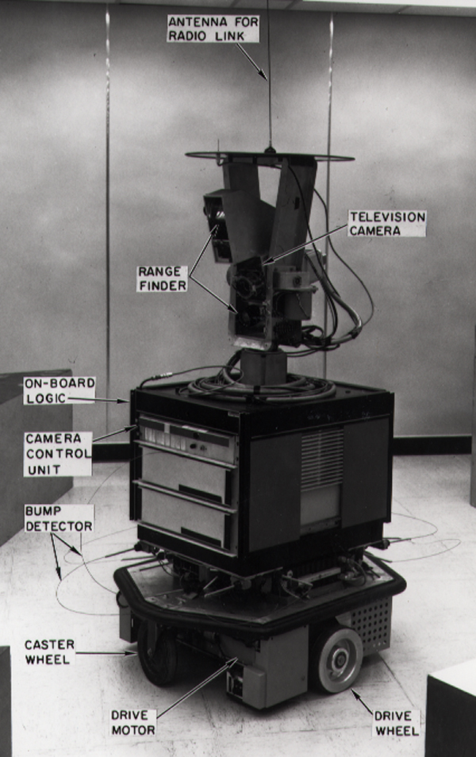
Shakey the robot (1966-1972)
Stanford Research Institute Problem Solver (STRIPS)
Operating Environment
Indoors
Engineered
Sensors
Wheel encoders
Bump detector
Sonar range finder
Camera

Slide 4
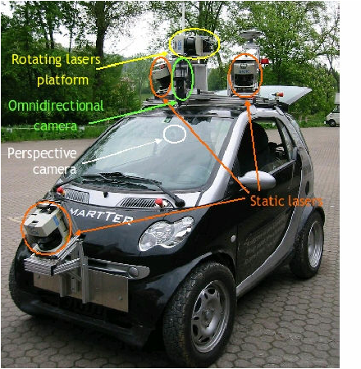
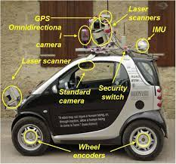
The SmartTer Platform (2004-2007)
SICK and 3D SICK laser scanners
Omnidirectional and Monocular camera
Motion Estimation / Localization
GPS system
Optical Gyro
Odometry
Internal car state sensors
Vehicle state flags (engine, door, etc.)
Engine data, gas pedal value
Camera for life video streaming
Transmission range up to 2 km

Slide 5
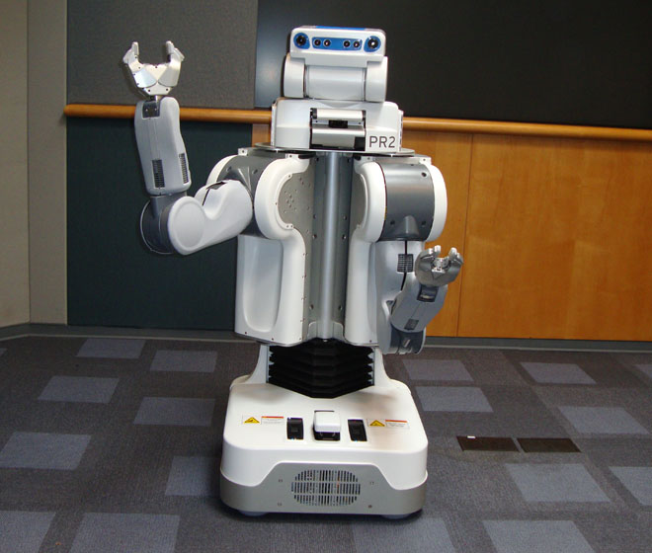
PR2 (2010), WILLOW
Operating Environment
Indoors and outdoors
Onroad only
Sensors
Wheel encoders
Bumper
IR sensors
Laser range finder
3D nodding laser range finder
Inertial measurement unit
Pan-tilt stereo camera with
texture projector (active)
Pressure sensor and accelerometer inside hands

Slide 6
Mobile robot components

Slide 7
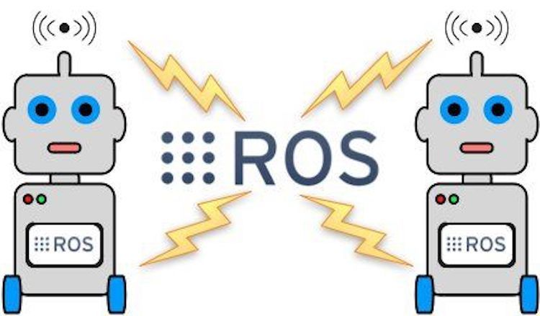
Basic of Mobile Robot Components
Hardware
Base platform
Energy Source
Actuator
Sensors
Processor
Software
Operating System
Localization
Mapping
Motion Planning
Visualization

Slide 8
Classification of Sensors

Slide 9
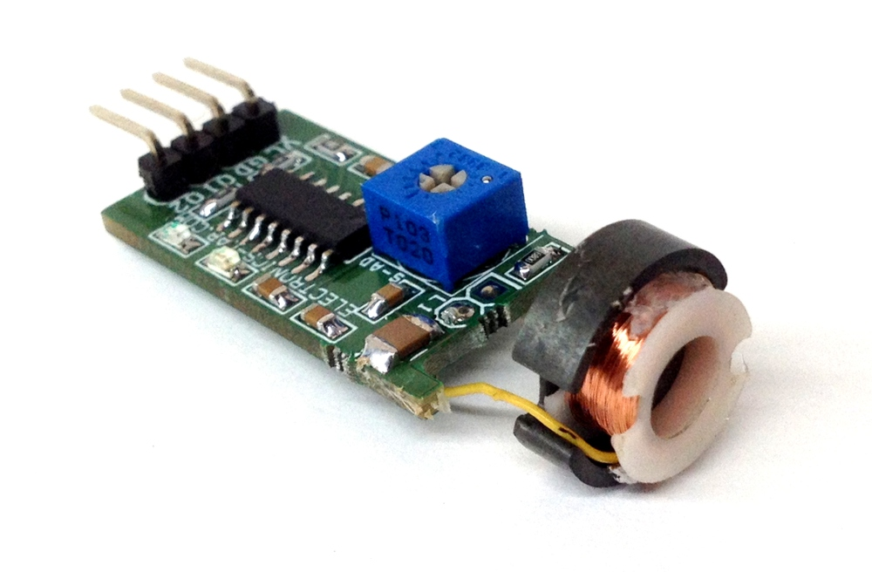
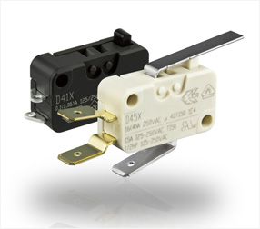
Tactile sensors
Detection of physical contact
Contact switches, bumpers optical barriers, Noncontact proximity sensors

Slide 10
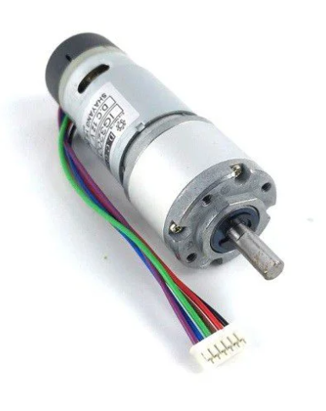
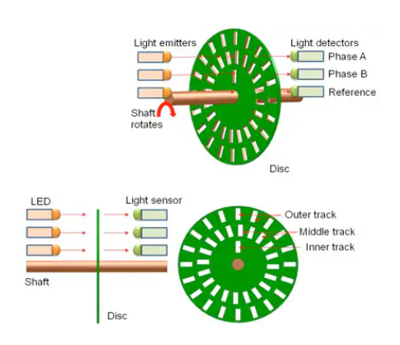
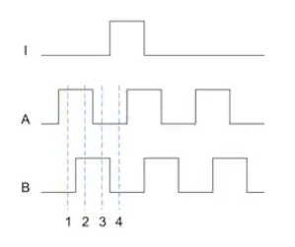
Wheel/motor sensors
Wheel/motor speed and position
Optical encoders, Magnetic encoders

Slide 11
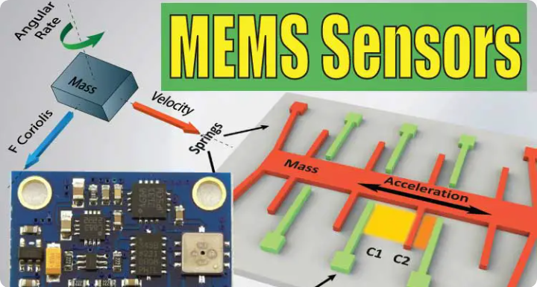
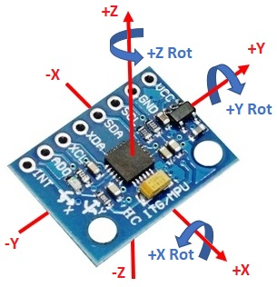
Heading sensors
Orientation of the robot in relation to a fixed reference frame
Compass, Gyroscopes, Inclinometers, Accelerometer

Slide 12
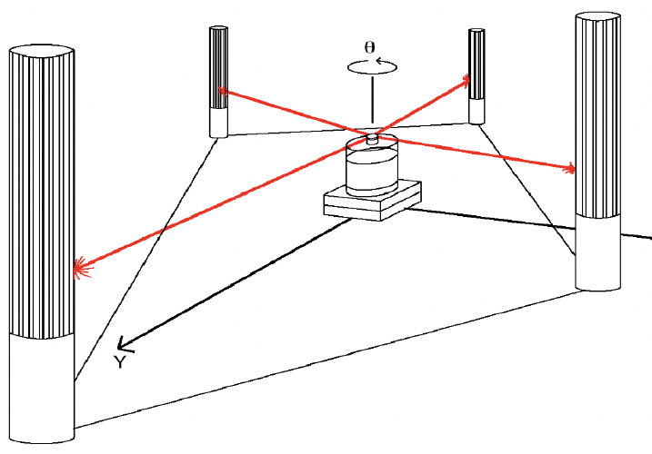
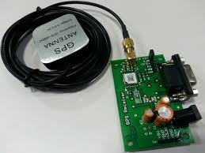
Ground-based positioning
Localization in a fixed reference frame
GPS, Active optical or RF beacons Active ultrasonic beacons Reflective beacons

Slide 13
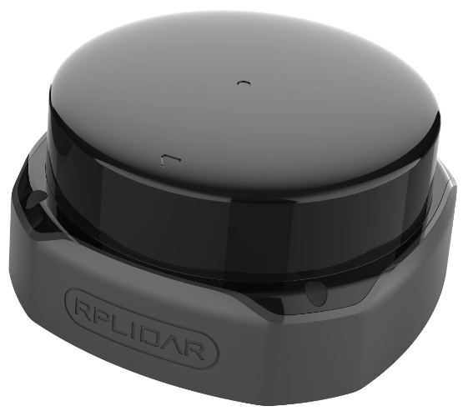
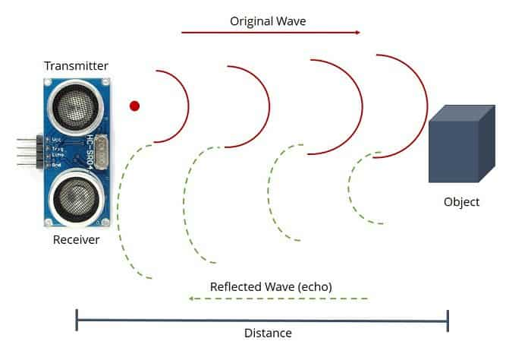
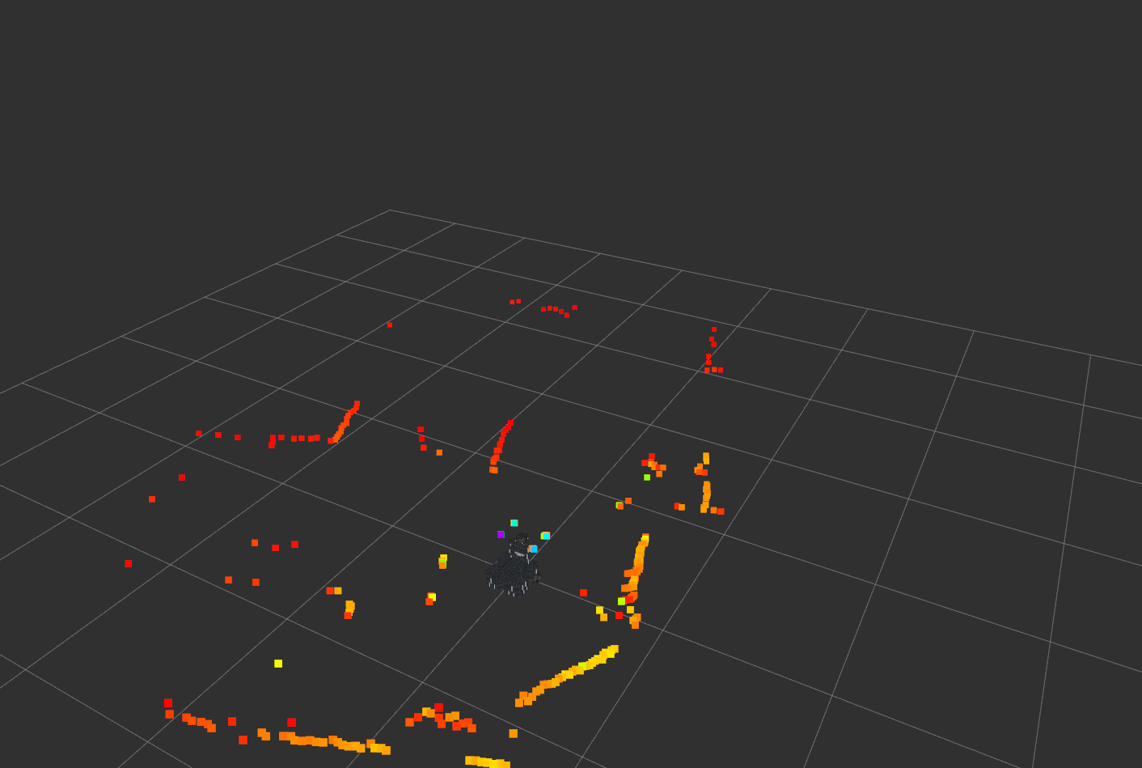
Active ranging
Reflectivity, time-of-flight, and geo-metric triangulation
Reflectivity sensors, Ultrasonic sensor, Laser rangefinder

Slide 14
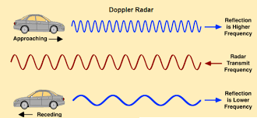
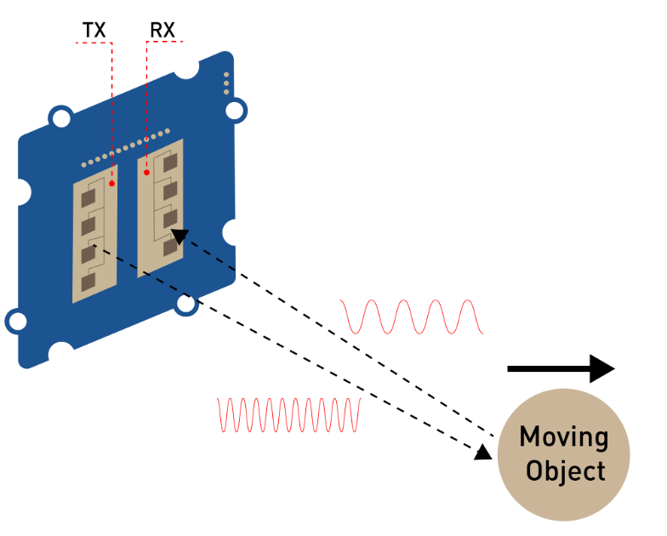
Motion/speed sensors
Speed relative to fixed or moving object
Doppler radar, Doppler sound

Slide 15
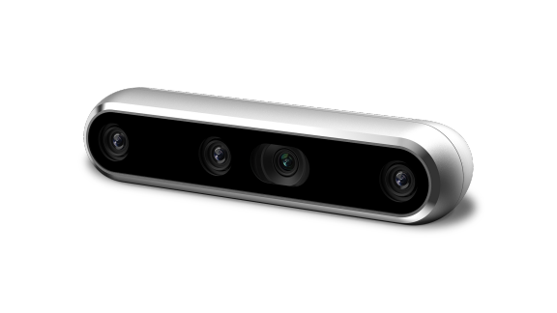
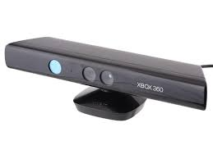
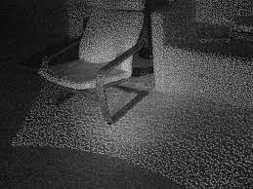
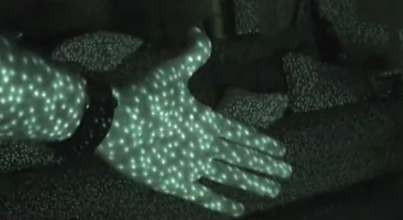
Vision-based sensors
Visual ranging, whole-image analysis, segmentation, object recognition
CCD/CMOS camera Visual ranging packages Object tracking packages

Slide 16
Ubuntu
(Open-source Operating System)

Slide 17
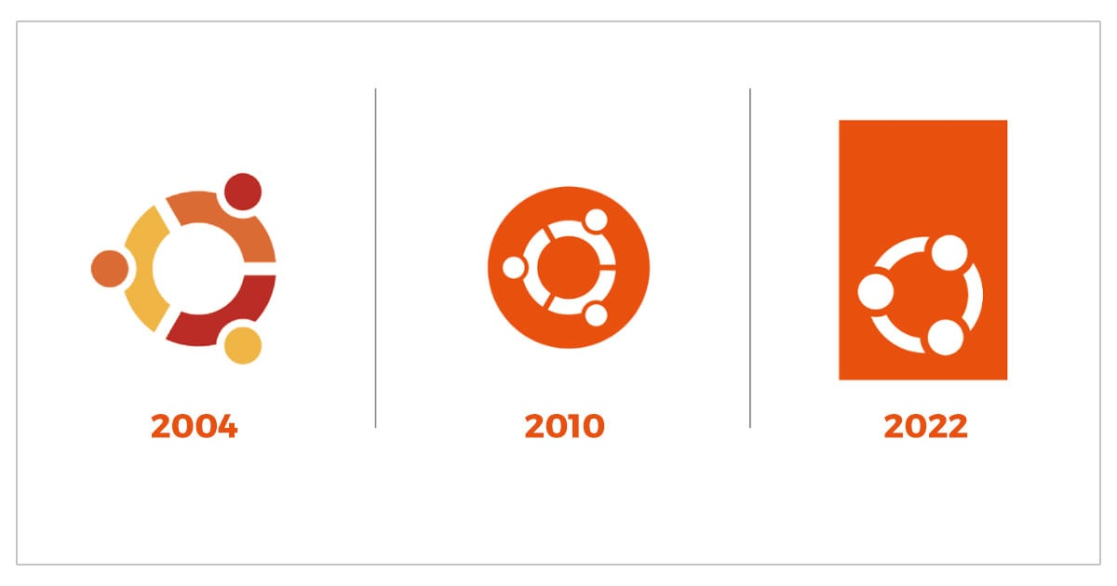
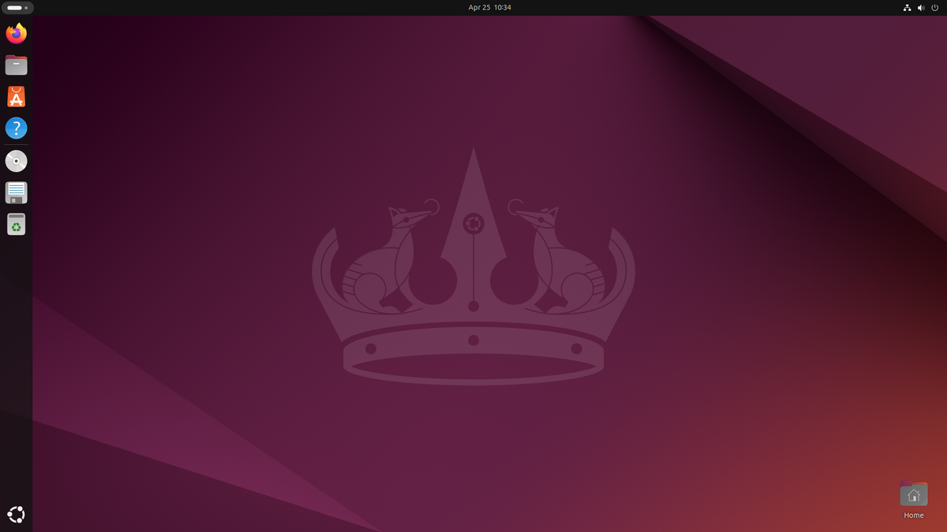
Free to Use
Better Community Support
Secure
Can revive older computers
Perfect For Programmers
Software Updates
Customization

Slide 18
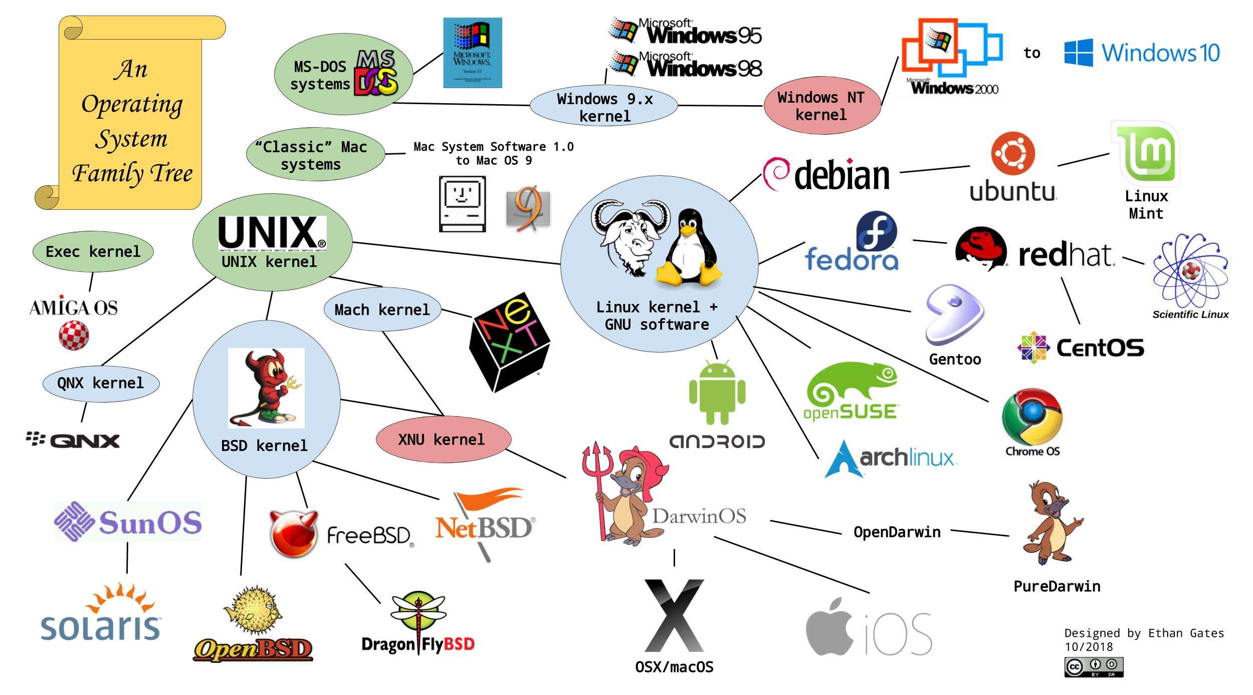
Operating system family

Slide 19
Robot Operating System (ROS)

Slide 20
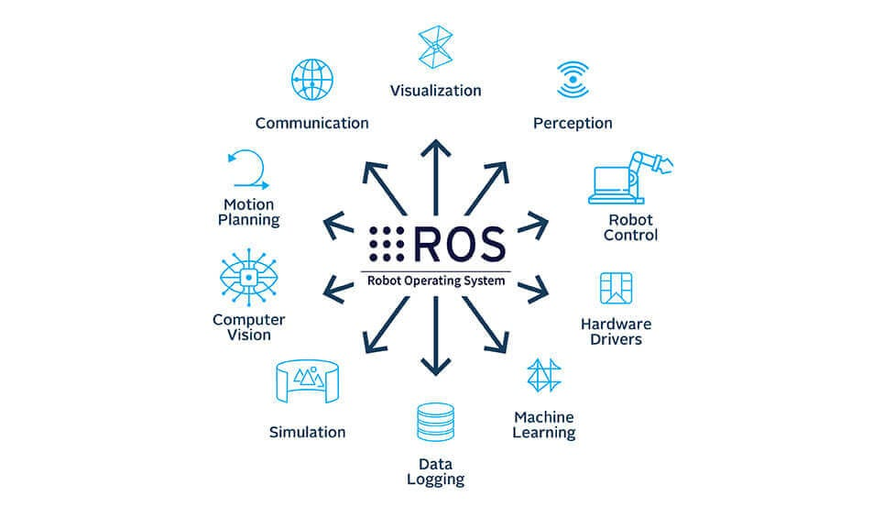

Slide 21
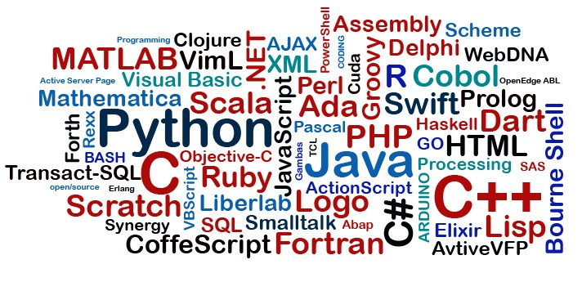
ROS Key feature
Main client libraries
Python
C++
Lisp
Experimental client library
Java
Lua

Slide 22
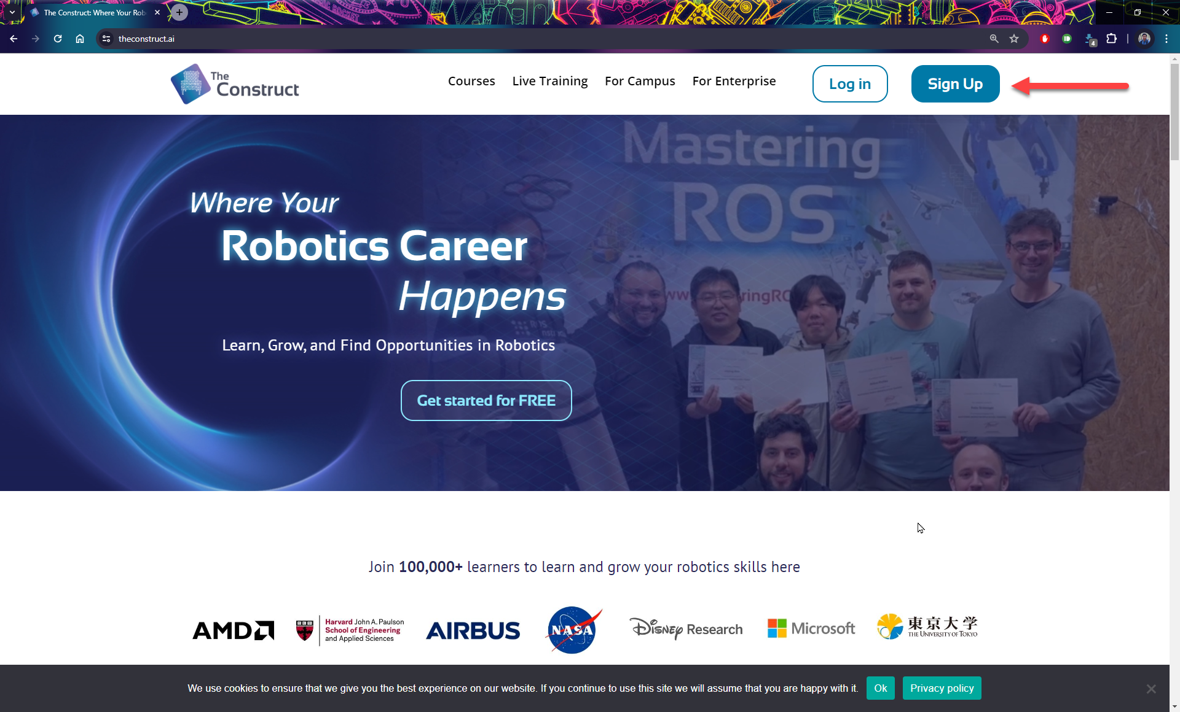
https://www.theconstruct.ai
The Construct is an e-learning platform for ROS and Robotics

Slide 23
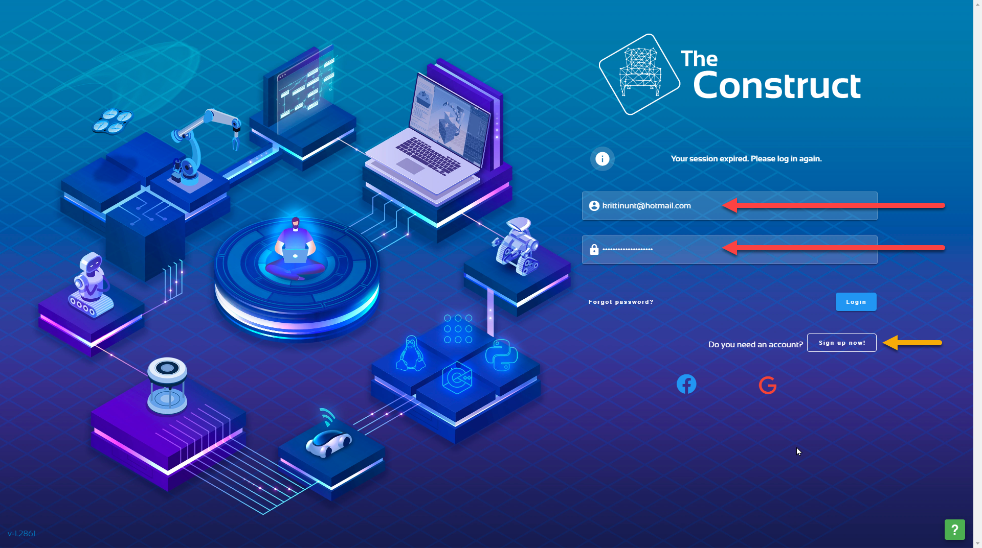

Slide 24
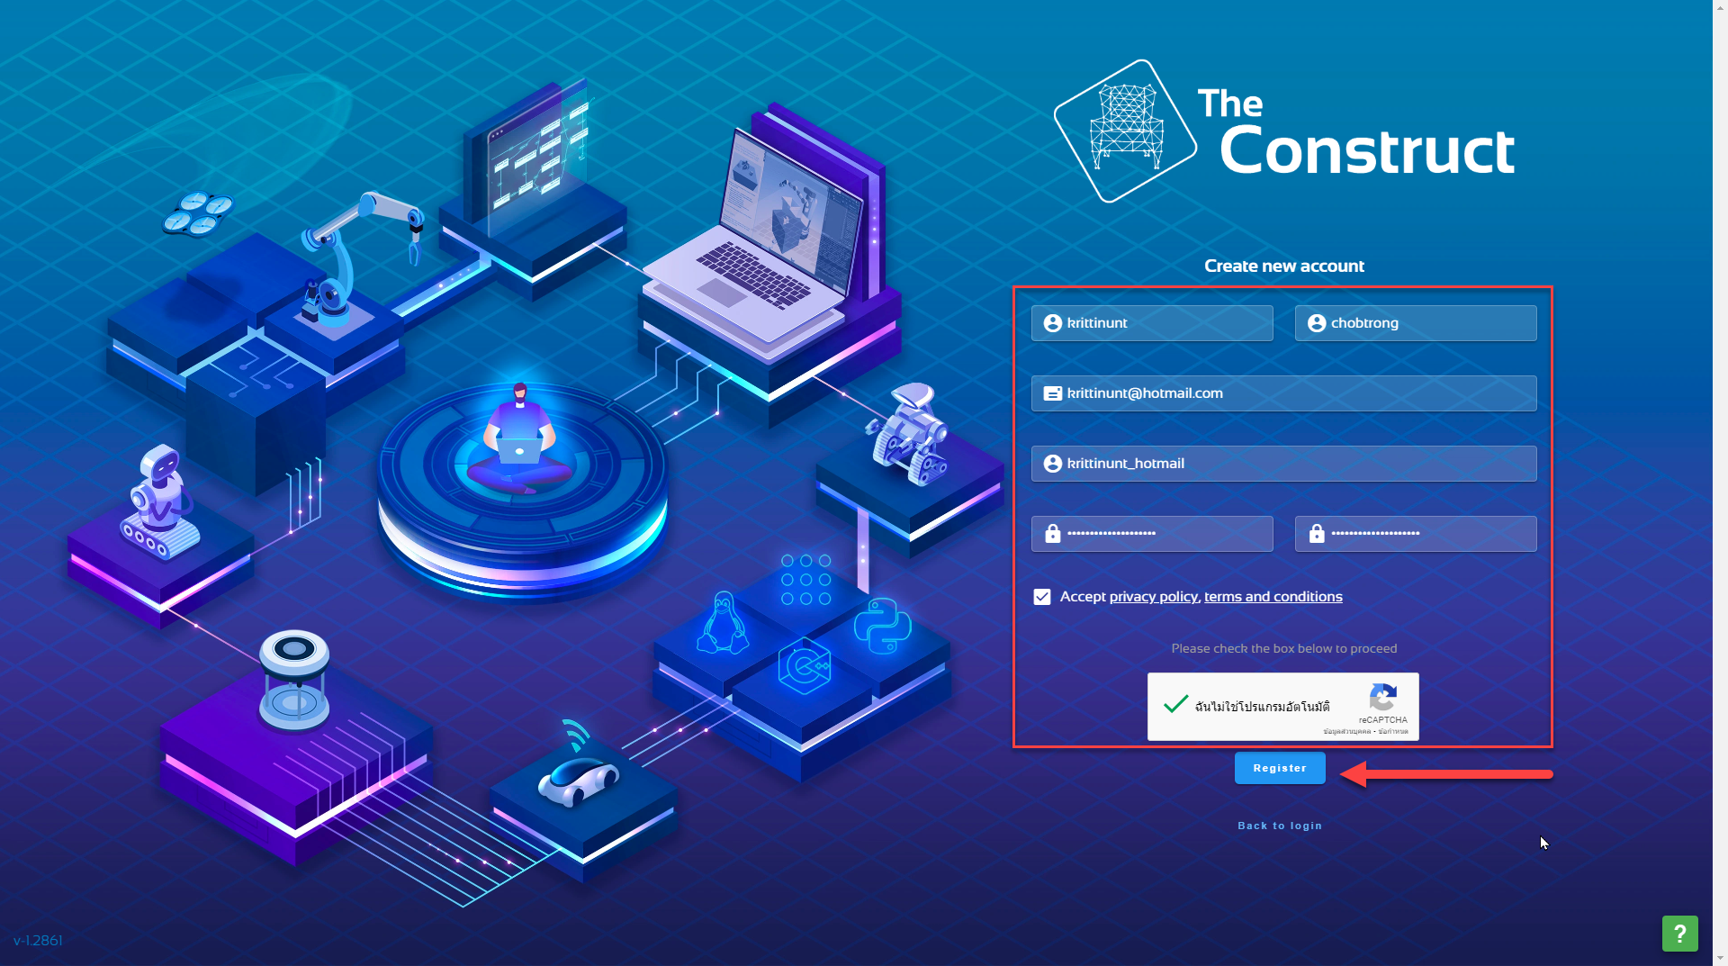

Slide 25
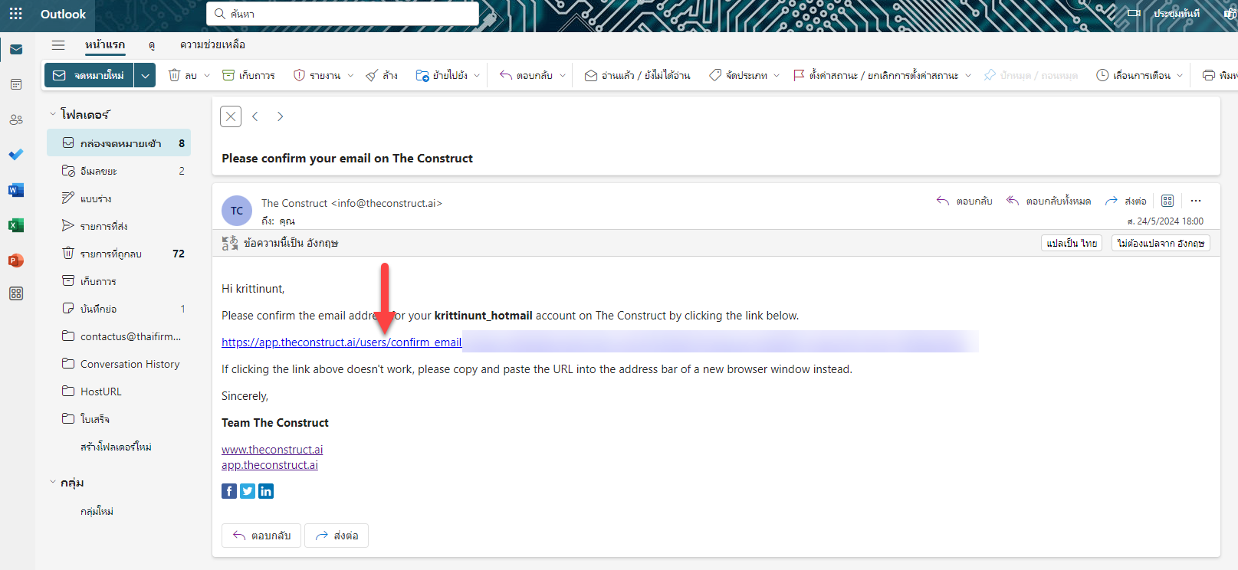

Slide 26
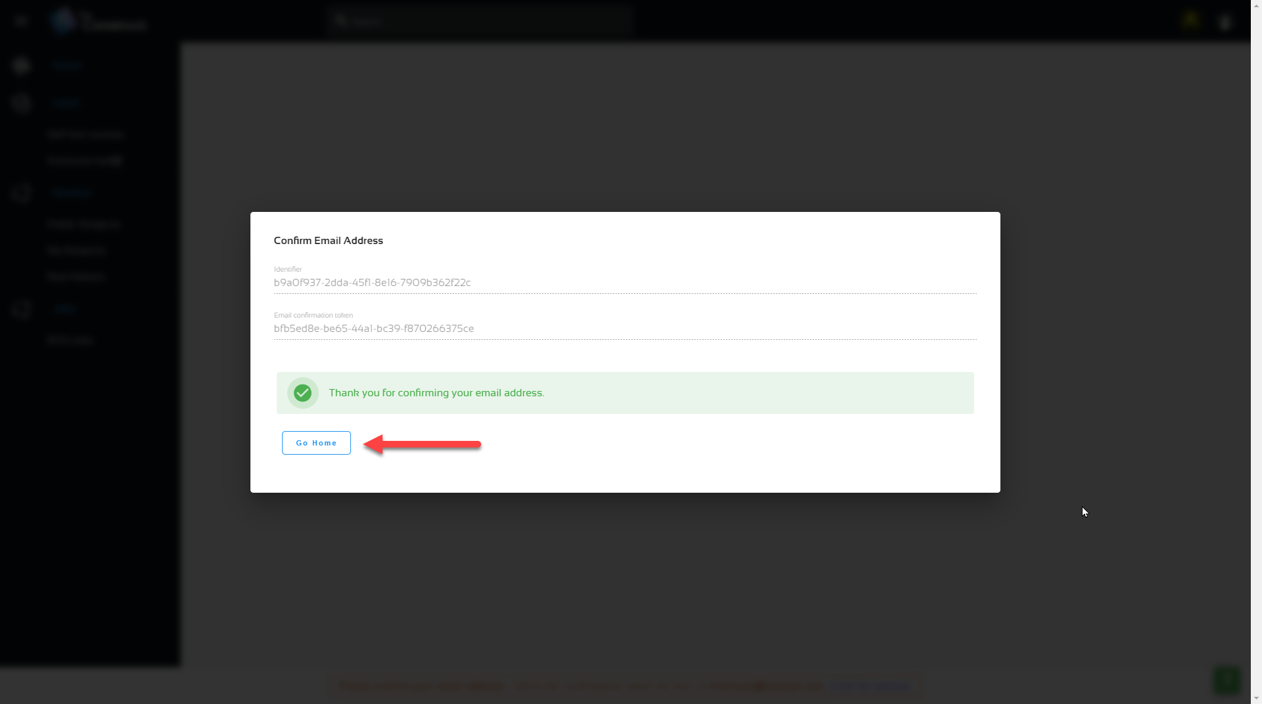

Slide 27
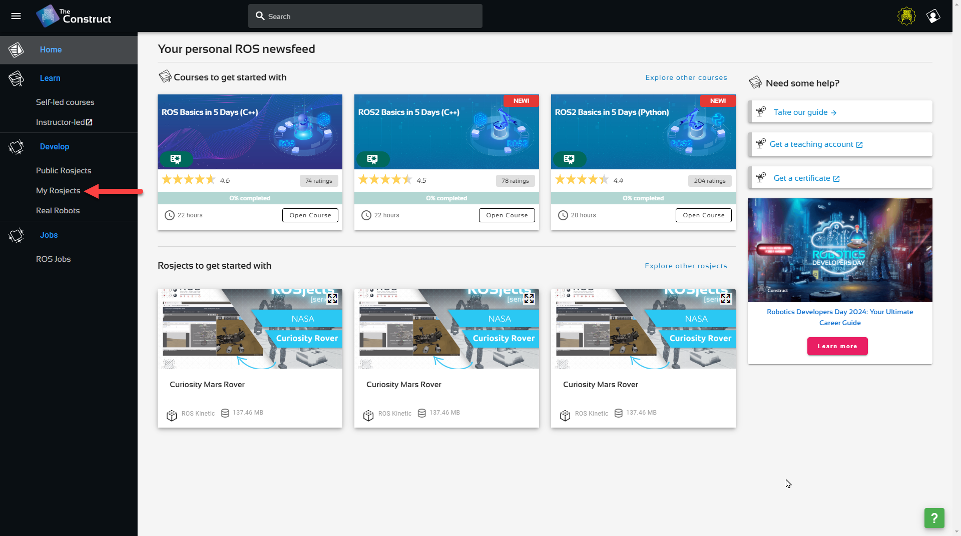

Slide 28
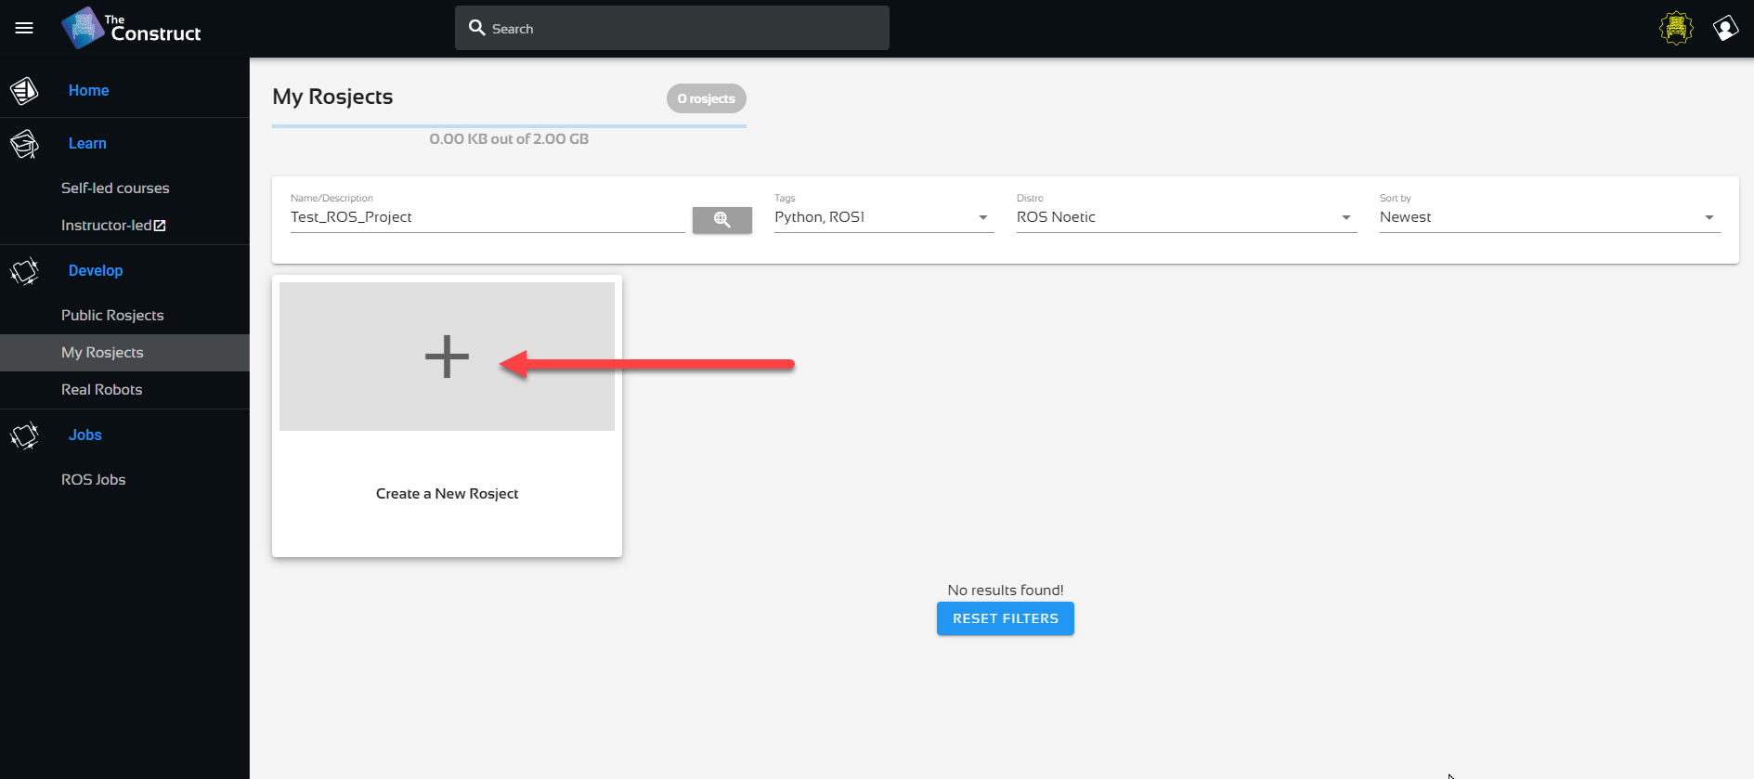

Slide 29
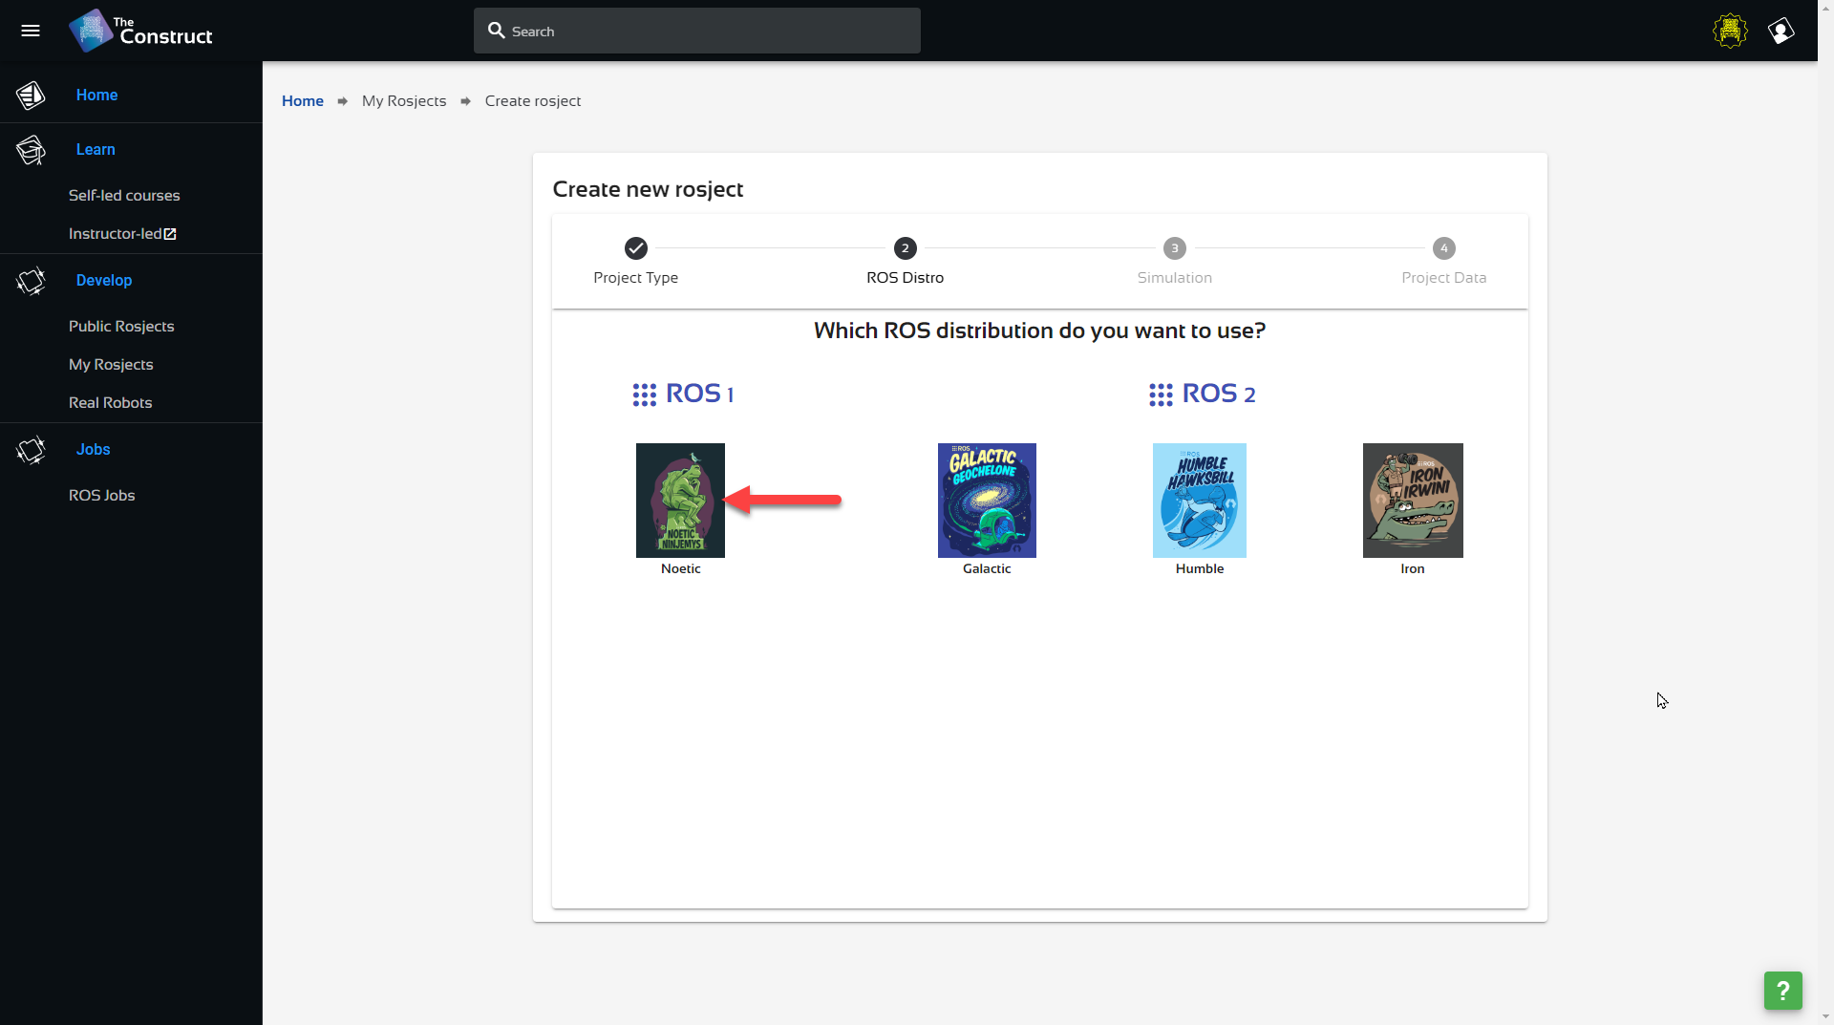

Slide 30
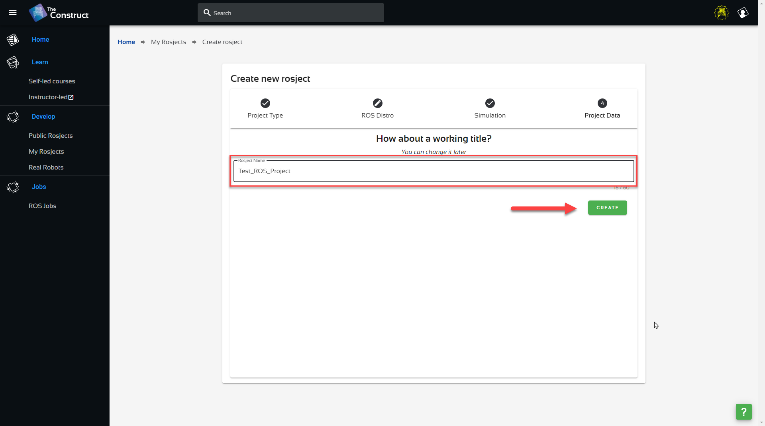

Slide 31
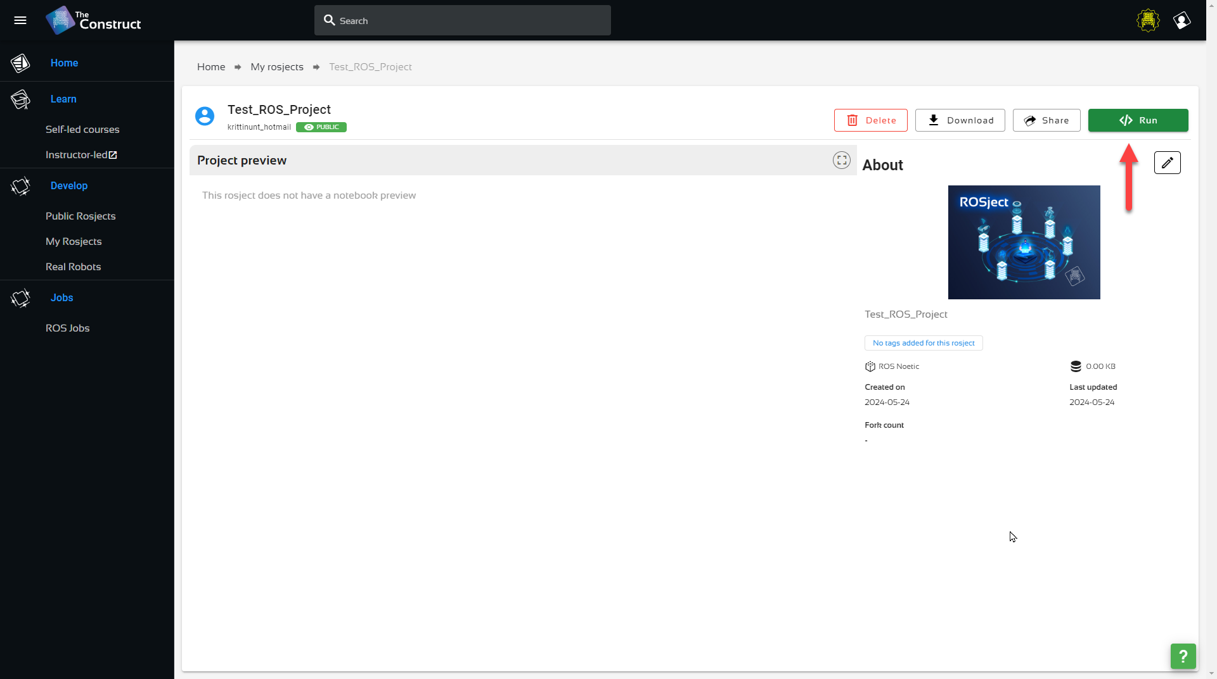

Slide 32
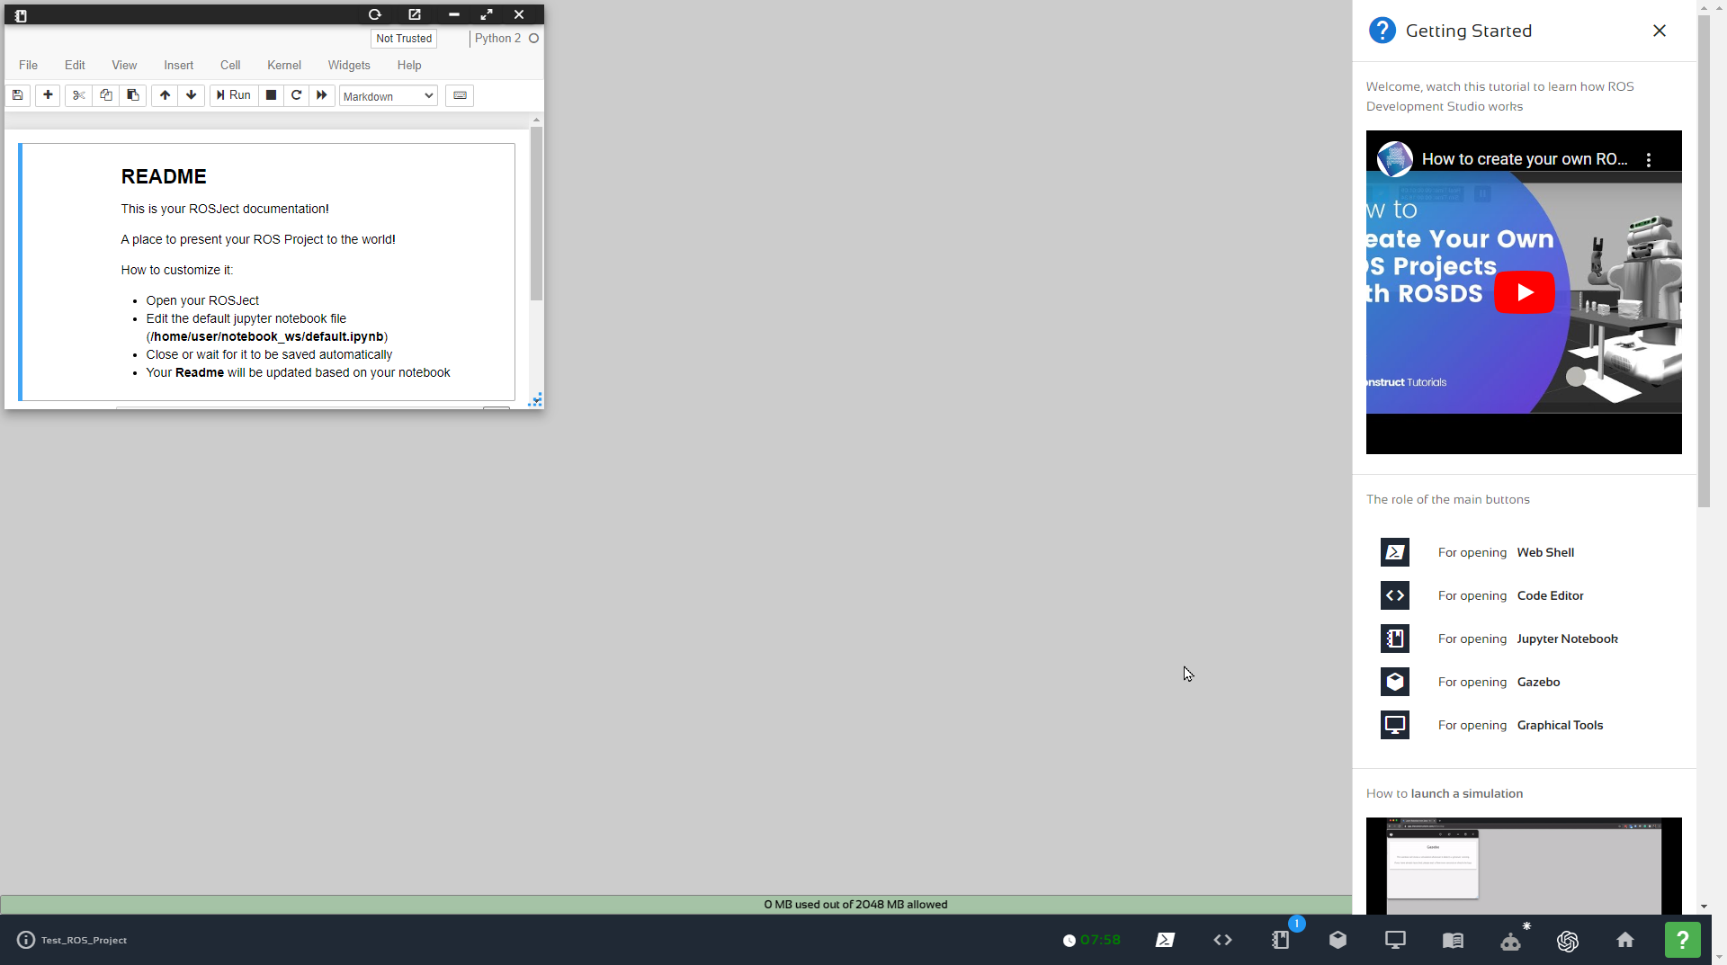

Slide 33
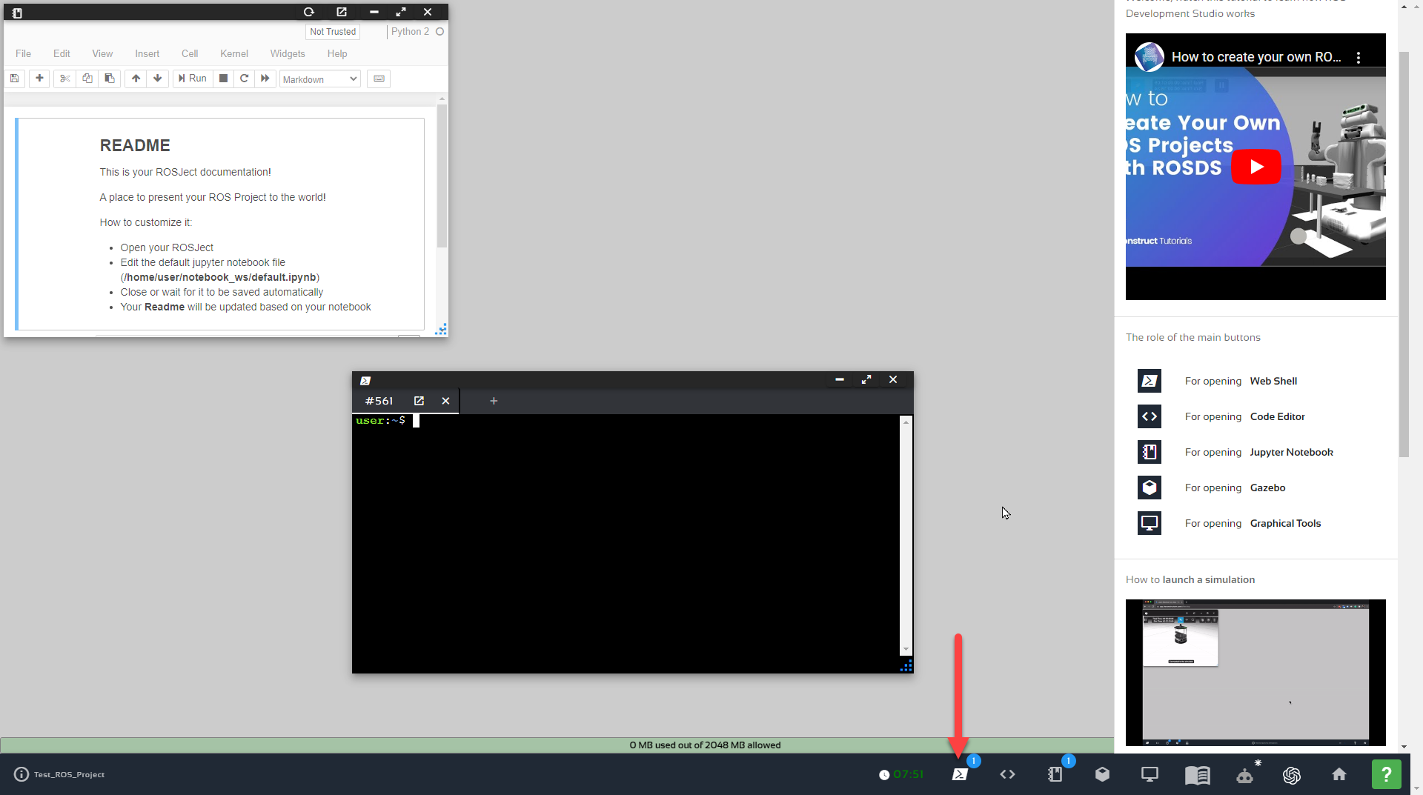

Slide 34
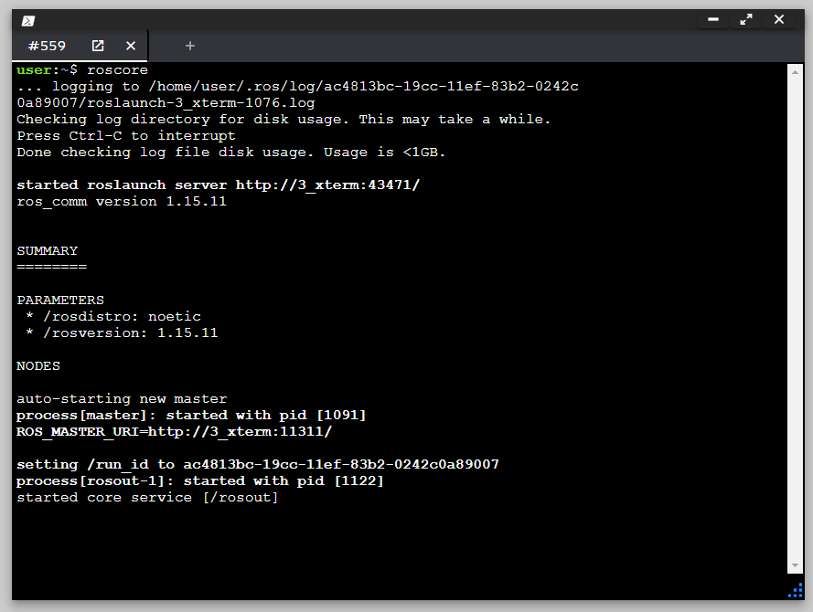
ROS Nodes / roscore
roscore is the first thing you should run when using ROS.
$roscore

Slide 35
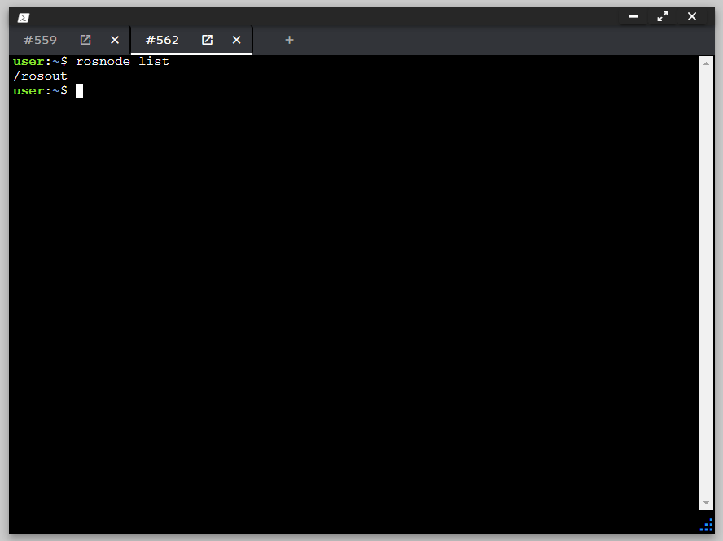
ROS Nodes / rosnode
rosnode display information about the ROS nodes that are currently running
$rosnode list

Slide 36
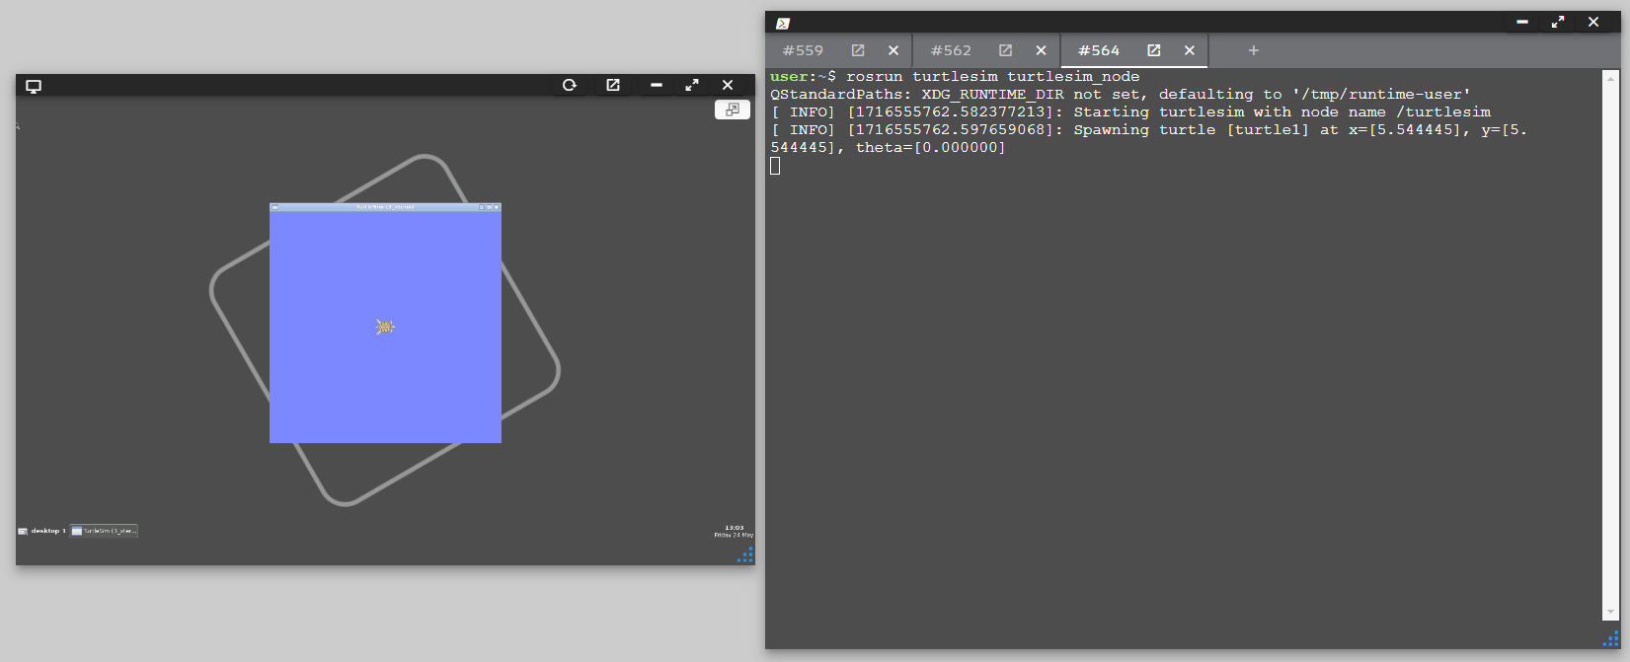
ROS Nodes / rosrun
rosrun allows you to use the package name to directly run a node within a package
$rosrun turtlesim turtlesim_node

Slide 37
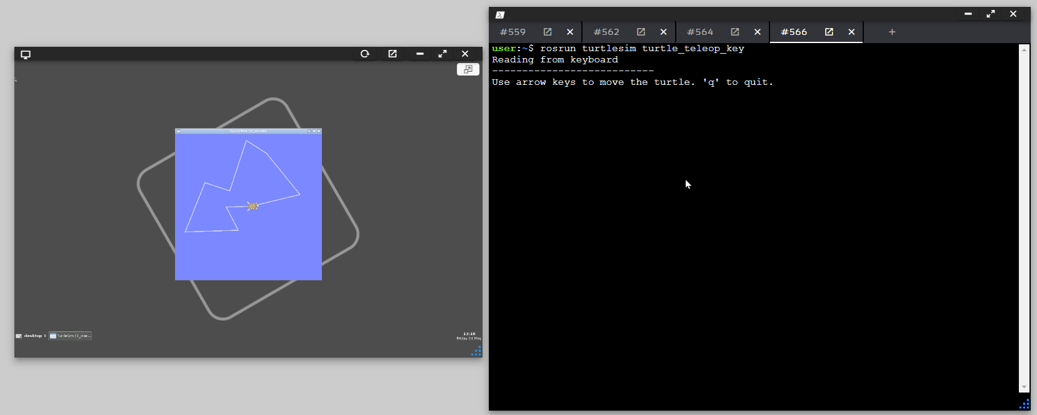
ROS Node / Topics
Publishing the keystrokes on a topic
$rosrun turtlesim turtle_teleop_key

Slide 38
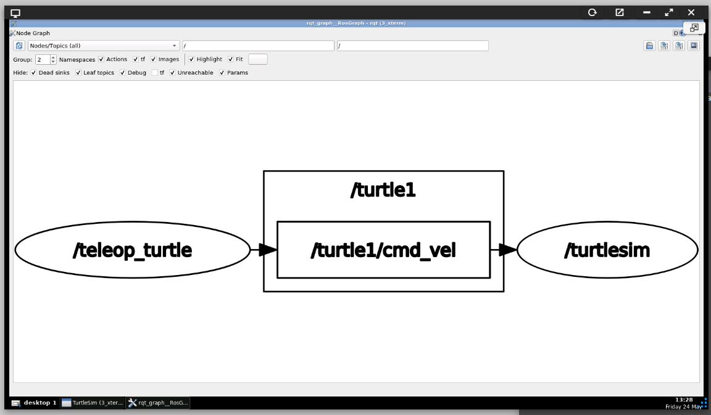
ROS Node / Topics
ROS Graph
$rosrun rqt_graph rqt_graph

Slide 39
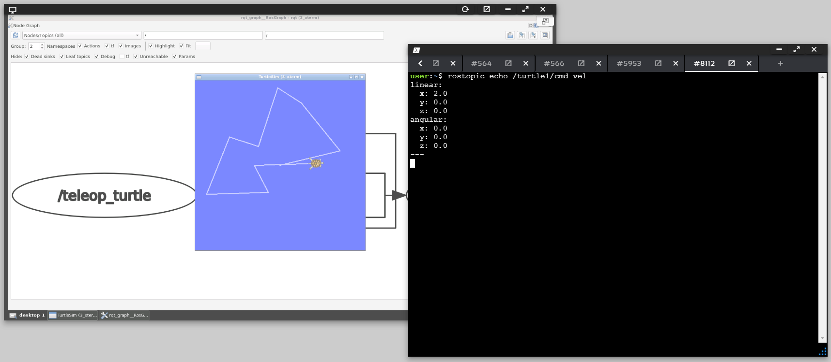
ROS Node / Topics / Echo
Show data published
$rostopic echo /turtle1/cmd_vel

Slide 40
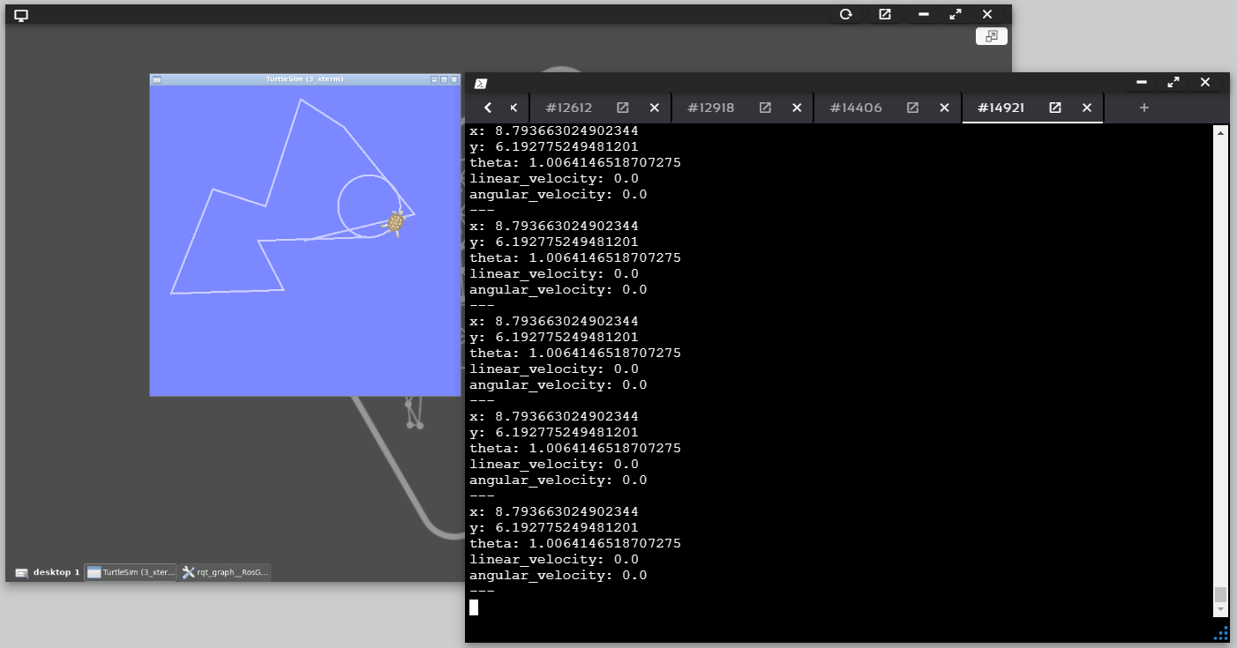
ROS Node / Topics / Echo
Show position data
$rostopic echo /turtle1/pose

Slide 41

ROS Node / Topics / List
Show published and subscribed topics
$rostopic list

Slide 42

ROS Node / Topics / Check type
Check type of I/O data parameters
$rostopic type /turtle1/cmd_vel
$rosmsg show geometry_msgs/Twist

Slide 43

ROS Node / Topics / Pub
Published data
$rostopic pub -1 /turtle1/cmd_vel geometry_msgs/Twist -- '[2.0, 0.0, 0.0]' '[0.0, 0.0, 1.8]'

Slide 44



